Slide 1
Breast Cancer
Supervised by prof. Ahmed Said Eltarass

Slide 2
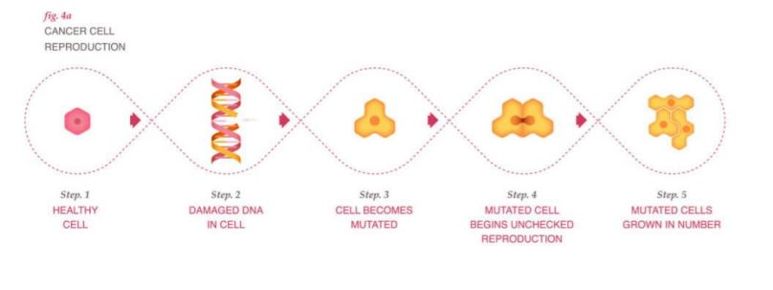
Introduction
Cancer is a disease in which cells in the body grow out of control.
Breast cancer is the most common cancer in women.
Each year in the United States, about 255,000 cases of breast cancer are diagnosed in women and about 42,000 women in the U.S. die each year from breast cancer.
In Egypt, breast cancer is the most common type of cancer among females.
What is breast cancer? What are its symptoms? What can we do as engineers to help them?

Slide 3
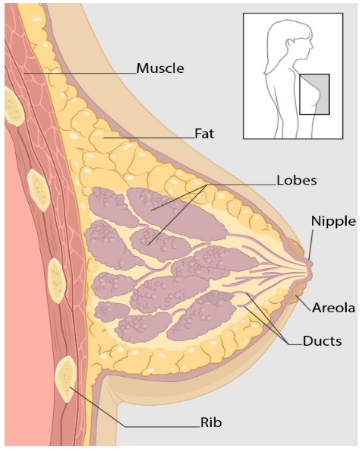
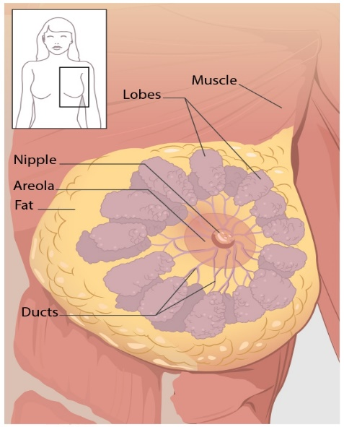
What Is Breast Cancer?
Breast cancer is a disease in which cells in the breast grow out of control.
There are different kinds of breast cancer depending on which cells in the breast turn into cancer.
The most common kinds of breast cancer are—
Invasive ductal carcinoma. The cancer cells begin in the ducts and then grow outside the ducts into other parts of the breast tissue.
Invasive lobular carcinoma. Cancer cells begin in the lobules and then spread from the lobules to the breast tissues that are close by.

Slide 4
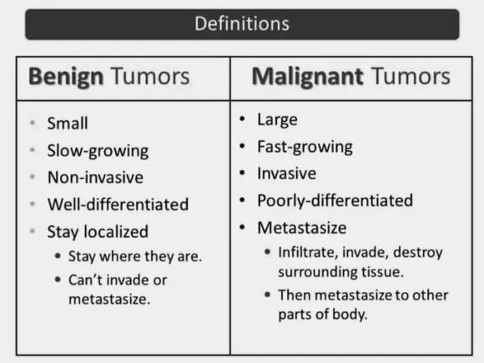
Tumors
Cells start to grow uncontrollably. These cells may form a mass called a tumor.
A tumor can be :
Malignant.
Benign.
A malignant tumor: means it can grow and spread to other parts of the body.
A benign tumor : means the tumor can grow but will not spread.

Slide 5
What Are the Symptoms of Breast Cancer?
Different people have different symptoms of breast cancer. Some do not have any signs or symptoms at all.
Some warning signs of breast cancer are—
New lump in the breast or underarm (armpit).
Thickening or swelling of part of the breast.
Irritation or dimpling of breast skin.
Redness or flaky skin in the nipple area or the breast.
Pulling in of the nipple or pain in the nipple area.
Nipple discharge other than breast milk, including blood.
Any change in the size or the shape of the breast.
Pain in any area of the breast.

Slide 6
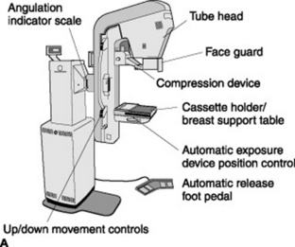
What Is Breast Cancer Screening?
Breast cancer screening means checking a woman’s breasts for cancer before there are signs or symptoms of the disease.
Although breast cancer screening cannot prevent breast cancer, it can help find breast cancer early, when it is easier to treat.
There is a lot of screening options for breast cancer but the most common are—
Mammogram a mammogram is an X-ray of the breast. For many women, mammograms are the best way to find breast cancer early.
Breast Magnetic Resonance Imaging (MRI) a breast MRI uses magnets and radio waves to take pictures of the breast.

Slide 7
(BI-RADS)
(BI-RADS) The Breast Imaging Reporting and Data System.
a standardized numerical scale system, ranging from 0 to 6, of reporting breast cancer risk.
0 | Incomplete | Your mammogram didn't give the enough information to make a clear diagnosis; follow-up imaging is necessary.
1 | Negative | There is nothing to comment on; routine screening is recommended.
2 | Benign | A definite benign finding; routine screening is recommended.
3 | Probably benign | Findings have a high probability of being benign, or noncancerous (>98%); six-month follow-up is recommended.
4 | Suspicious abnormality | Finding is not characteristic of breast cancer, but there is a possibility of malignancy, or cancer (3%–94%); biopsy should be considered.
5 | Highly suspicious of malignancy | Lesion that has a high probability of being malignant (>= 95%) is detected; take appropriate action as recommended by your healthcare provider.
6 | Known biopsy proven malignancy | Lesions known to be malignant are being imaged prior to definitive treatment; assure that treatment is completed.

Slide 8
Mammography screening
A mammogram is a 2D image that help to identify suspicious findings

Slide 9
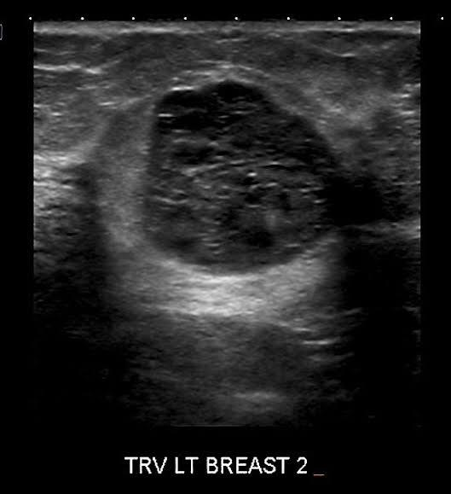
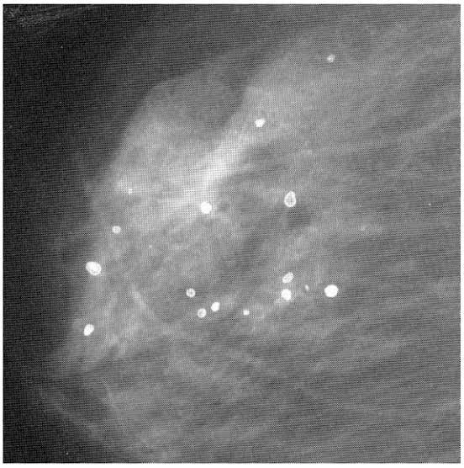
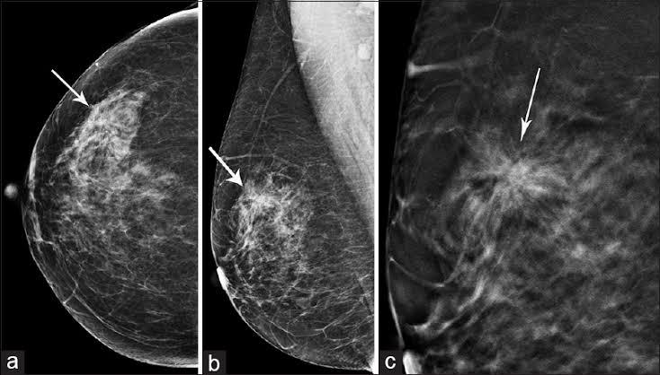
Mammography abnormalities
Abnormalities in mammograms:
Mass lesions: they have high ,medium or low density compared to normal fibro-glandular tissue
Micro Calcification: they are small calcium deposits
Architectural Distortion: Their appearance increase suspicions that the patient may have breast cancer

Slide 10
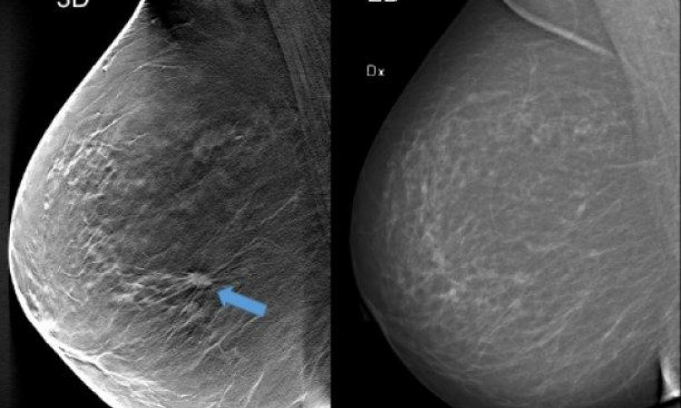
How to use mammogram
Breast tissue is pressed by a plat
Penetrate low energy (20-32 kVp) X-ray
Radio graphic image is produced

Slide 11
Benefits and Risks of Screening
ADVANTAGE
Reduces the risk of dying from breast cancer Of 1,000 women who have a mammogram every 2 years for 20 years, 7 deaths are prevented
Reduces the risk of having to undergo chemotherapy Screening often allows for the detection of cancers at an early stage of development. Treatment is then possible without chemotherapy.
Allows women to know the health of their breasts The vast majority of women (nearly 98 %) will not have breast cancer if their mammograms and additional examinations do not reveal cancers.
DISADVANTAGE
Periods of waiting and anxiety when additional examinations are required Almost half the women who participate in the screening for 20 years (453 in 1,000) have at least one additional examination. This represents 156 more women than in the 1,000 who do not participate in the screening.
Possible overdiagnosis Of 77 breast cancer diagnoses, 10 would be cases of overdiagnosis.
Overdiagnosis is the discovery of a cancer that would never have been detected without screening. It can happen that a woman receives a diagnosis for cancer that would never have had an effect on her health or consequences on her life – like a cancer that develops very slowly or a benign cancer. This could happen to participants in the screening program because a mammogram detects breast cancer in the early stages of development.
However, given that it is still impossible to differentiate between harmless cancers and deadly ones, all cancers are treated. As such, women in the screening program could:
Receive treatment that would not be necessary
Suffer the side effects of these treatments
Have to live with the experience of having been diagnosed with cancer

Slide 12
The benefits of Deep learning
As we can see there is a human error in the diagnosis of breast cancer which can lead to a much more problems for the patients.
How can engineering help them to more efficient?
The answer is the use of machine learning and deep learning which can help the doctors and the patients getting a better diagnosis of the breast cancer.
By training a pre-trained model on a set of data of mammograms, it can detect the cancer whether it is malignant or benign and needs treatment right now.

